Slide 1
ASP.NET Core
14-15 th April 2018

Slide 2
About me
ASP.NET, C# Developer
5 years software engineer experience
More then 10 project
.Net Core
ASP Classic
Web Forms
MVC

Slide 3
Summary
Introduction to MVC
Introduction to .Net Core
Controller
Routing
Razors
Model binding & ViewModels
Validation
Filters & Security

Slide 4
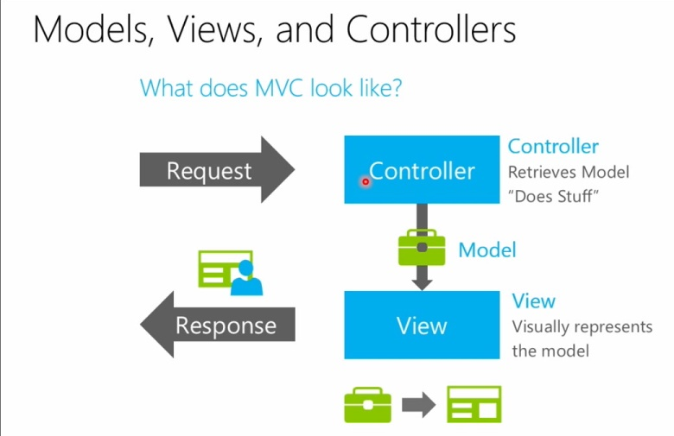
All about MVC

Slide 5
All about.NET Core
ASP.NET 5 is now renamed as ASP.NET Core 1.0
.NET Framework 5 will be known as .NET Core 1.0 and
Entity Framework 7 will be renamed to Entity Framework Core 1.0.

Slide 6
Key features .NET Core
Open-Source
Cross-platform
Web applications, IOT apps and mobile backends
Cloud ready
Performance
Built-In Dependency Injection
ETC

Slide 7
Controller

Slide 8
The Controller Responsibilities
Handle the Request
Build a Model
Send the Response

Slide 9
What is a Controller?
http://localhost/Customer

Slide 10
Action Methods
Any Public method exposed by a Controller is called an Action method
http://localhost/Customer/List

Slide 11
Action method results
ViewResult – Represents HTML and markup
EmptyResult – Represents no result
RedirectResult – Represents a redirection to a new URL
JsonResult – Represents a JavaScript Object Notation result that can be used in an AJAX application
JavaScriptResult – Represents a JavaScript script
ContentResult – Represents a text result
FileContentResult – Represents a downloadable file (with the binary content)
FilePathResult – Represents a downloadable file (with a path)
FileStreamResult – Represents a downloadable file (with a file stream)

Slide 12
Routing in ASP.NET Core

Slide 13
What is Routing in ASP.NET Core?
map any incoming request to a routing handler
find a route handler based on the URL or the information provided in the URL
generate URLs used in response

Slide 14
What are the components used in a simple routing operation?
RouteCollection of the app
RouterMiddleware
Controller

Slide 15
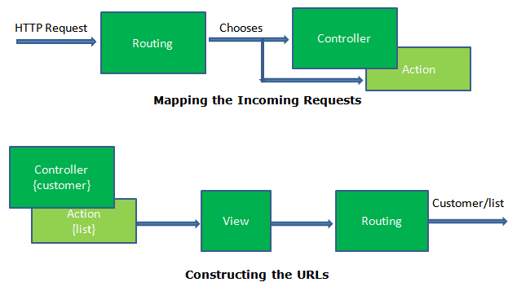
ROUTING IN ASP.NET MVC Core

Slide 16
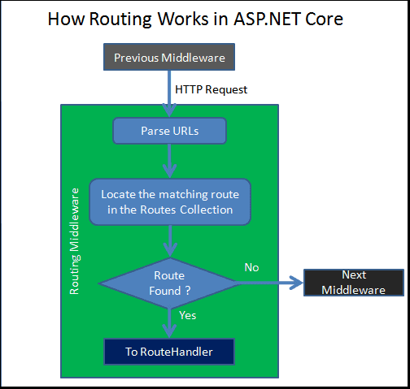
HOW ROUTING WORKS IN ASP.Net Core?

Slide 17
How to Set up Routes
Convention-based routing
Attribute routing

Slide 18
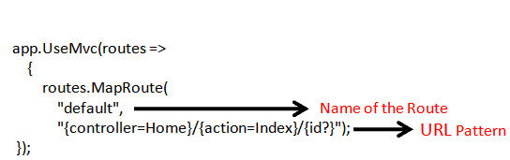
Convention Based Routing

Slide 19
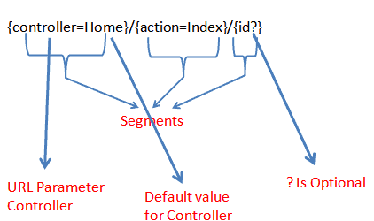
URL Patterns

Slide 20
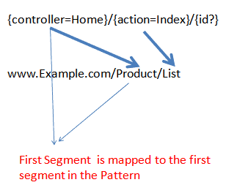
URL Matching

Slide 21

Routing in Action

Slide 22
Attribute Routing in ASP.NET Core
The attribute routing uses the attributes defined directly on the controller action to define the routes.

Slide 23
Razors

Slide 24
What is Razor?
Razor markup
C#
HTML
=>
.cshtml
Notes:
Razor is a markup syntax for embedding server-based code into webpages.

Slide 25
Razor syntax
@
+
Keyword

Slide 26
Implicit Razor expressions
<p>@DateTime.Now</p>
<p>@await DoSomething("hello", "world")</p>
<p>@GenericMethod<int>()</p>

Slide 27
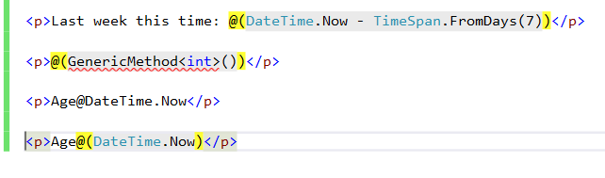
Explicit Razor expressions

Slide 28
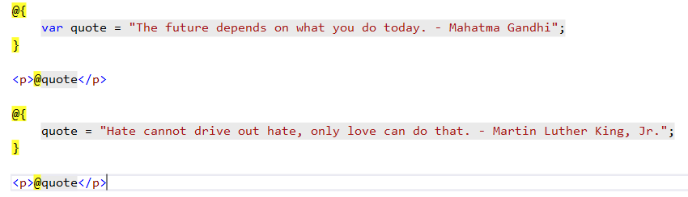
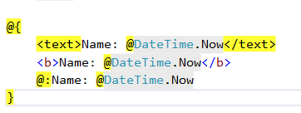
Razor code blocks
Notes:
Same scope

Slide 29
Control Structures
Conditionals
@if, else if, else
@switch
Looping
@for
@foreach
@while
@do while

Slide 30
Others
@try, catch, finally
@lock
@using

Slide 31
Model binding & ViewModels

Slide 32
What is model binding?
Model binding in ASP.NET Core MVC maps data from HTTP requests to action method parameters.

Slide 33
How model binding works
Form values
Route values
Query strings

Slide 34
How model binding works
Primitive type (int, string, double, etc)
name => name
Classes
parameter_name.property_name => person.name
property_name => name
Notes:
When a parameter is bound, model binding stops looking for values with that name and it moves on to bind the next parameter.

Slide 35
How model binding works
Collection
parameter_name[index] / [index] => persons[0]
Dictionary
parameter_name[key] / [key] => persons[“Tom”]
File
IFormFile, IEnumerable<IFormFile>
CancellationToken
Notes:
When a parameter is bound, model binding stops looking for values with that name and it moves on to bind the next parameter.
Used to cancel activity in asynchronous controllers

Slide 36
Default values
T[] -> Array.Empty<T>()
byte[] -> null
Reference Types -> instance of a class with the default constructor without setting properties
String -> null
Nullable Types -> null
Value Types -> default(T)

Slide 37
Default values
T[] -> Array.Empty<T>()
byte[] -> null
Reference Types -> instance of a class with the default constructor without setting properties
String -> null
Nullable Types -> null
Value Types -> default(T)
Notes:
If binding fails, MVC doesn't throw an error. Every action which accepts user input should check the ModelState.IsValid property

Slide 38
Customize model binding
BindRequired
BindNever
FromHeader, FromQuery, FromRoute, FromForm
FromServices
FromBody
ModelBinder
Notes:
This attribute uses dependency injection to bind parameters from services.

Slide 39
Validation

Slide 40
Validation Attributes
CreditCard
Url
EmailAddress
Phone
Range
RegularExpression
Required
StringLength

Slide 41
Validation Attributes
MVC supports any attribute that derives from ValidationAttribute for validation purposes. Many useful validation attributes can be found in the System.ComponentModel.DataAnnotations namespace.

Slide 42
Model State
Model state represents validation errors in submitted HTML form values.

Slide 43
Filters & Security

